Slide 1

Transformation of the Rio Grande Delta after One Hundred Years of Human Intervention
Proposal by
Edoardo Davila
MARS-5370

Slide 2
Introduction
The Rio Grande formed a sizable delta of around 7,770 km² that spans from Southeast Texas to Northeast Tamaulipas with a shoreline length of approximately 300 km, and begins near the city of Harlingen, 70 km from shore (Figure 1).
Nowadays, fifteen major dams and diversions, and many more minor structures, have been built in the last 100 years.
Amistad dam and Falcon dam are located at 546 km and 212 km from the mouth of the river, respectively.
Sinuosity is a common concept use in geomorphology to represent the ratio between river length and valley length

Slide 3
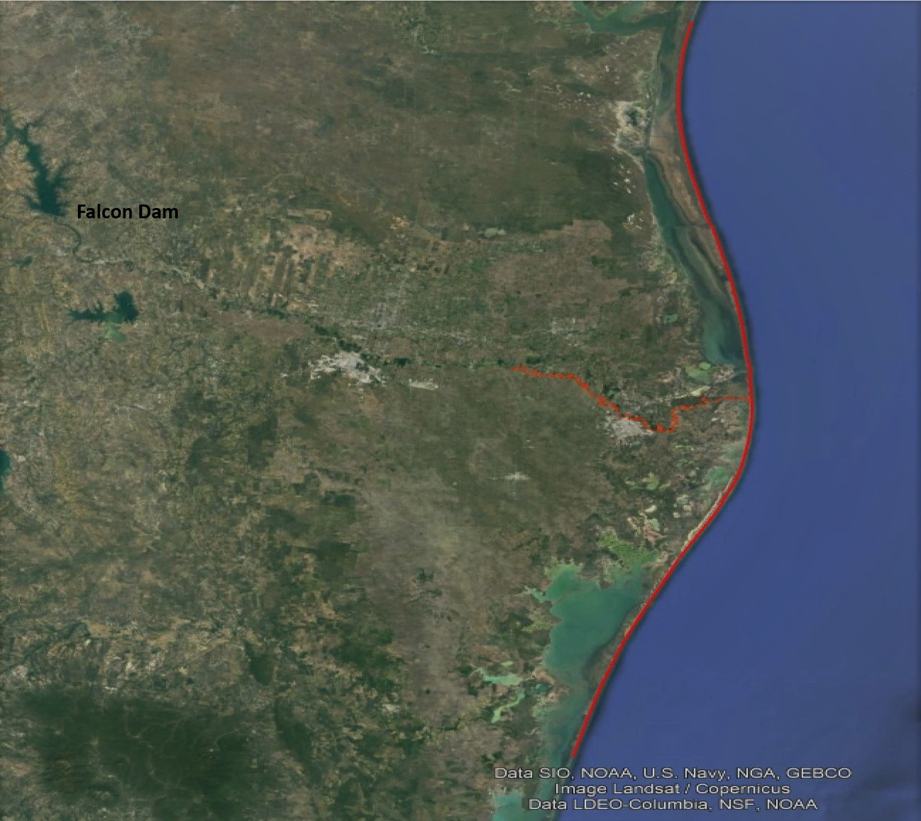
Figure 3. The Rio Grande delta. The Rio Grande and the delta shoreline are delineated in red. Falcon Dam is seen in the right up corner.

Slide 4
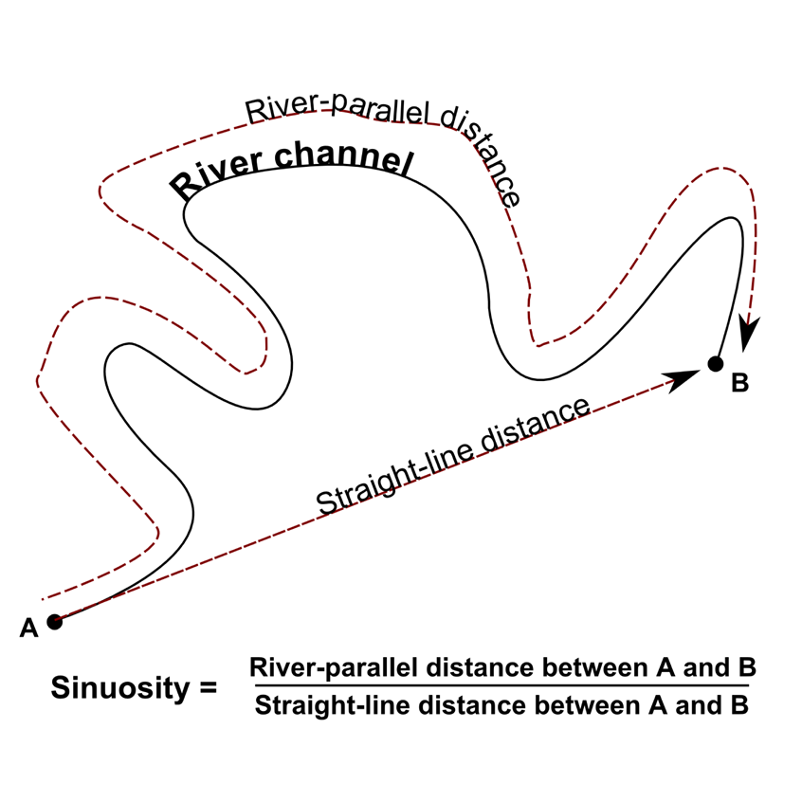
Figure 2. Sinuosity. River length indicates the distance travelled through the river. Valley length indicates the distance travel through the valley parallel to the river.

Slide 5
Objective
This study will test the hypothesis that as result of the significant decline of water discharge, and the almost complete elimination of suspended sediment to the coast, over the last one hundred years, the river has adjusted its channel in the delta region by reducing its sinuosity.
Has human activity changed the delta section of the Rio Grande?
Can sinuosity, flow, and sediment data provide enough data to proof that human activity has affected the river?
If change is detected, can it be related to human activity?

Slide 6
Methods
Aerial images published in 2014 and maps from 1912 to measure river length.
GIS provides the tools for georeferencing processes, creating models of the Rio Grande in 1912 and 2012, measuring valley length and river length.
Jupyter Lab will be used to obtain the sinuosity ratio for the Rio Grande and analyze discharge and sediment data.

